Slide 1
Digital Portfolio
STUDENT NAME: Lavanya .S
REGISTER NO AND NMID: 222401249 asunm11024ai139
DEPARTMENT: Bsc CS with Artificial intelligence
COLLEGE: D.R.B.C.C.C Hindu College Madras University

Slide 2
PROJECT TITLE
Digital Portfolio

Slide 3


AGENDA
Problem Statement
Project Overview
End Users
Tools and Technologies
Portfolio design and Layout
Features and Functionality
Results and Screenshots
Conclusion
Github Link
3/21/2024 Annual Review

Slide 4

PROBLEM STATEMENT
Students need a way to present their personal profile, skills, and interests online in a simple webpage format. A portfolio webpage helps in showcasing their identity and career goals.

Slide 5

PROJECT OVERVIEW
The Student Portfolio Website is a simple yet effective personal webpage created using HTML, CSS, and JavaScript. The project’s main goal is to provide students with a platform to showcase their profile, skills, projects, and contact details in a professional and attractive way.

Slide 6

WHO ARE THE END USERS?
Students (academic projects, resumes) Job seekers (to share with recruiters). Freelancers (to show clients). Professionals (to highlight experience and achievements).

Slide 7

TOOLS AND TECHNIQUES
HTML Structure (pages, sections). CSS Styling (colors, layouts, responsiveness). JavaScript Interactivity (navigation menu, animations, form validation), Mention code editor CODEPEN and hosting platform (GitHub Pages)
HTML Structure (pages, sections). CSS Styling (colors, layouts, responsiveness). JavaScript Interactivity (navigation menu, animations, form validation), Mention code editor (VS Code) or CODEPEN and hosting platform (GitHub Pages)

Slide 8
POTFOLIO DESIGN AND LAYOUT
Sections included: Home/About Me Projects Skills Contact Responsive layout (mobile desktop view).
8

Slide 9
FEATURES AND FUNCTIONALITY
Navigation bar with smooth scrolling. Project showcase with images/details. Interactive elements (hover effects, animations). Contact form (with validation). Responsive design for all devices.

Slide 10
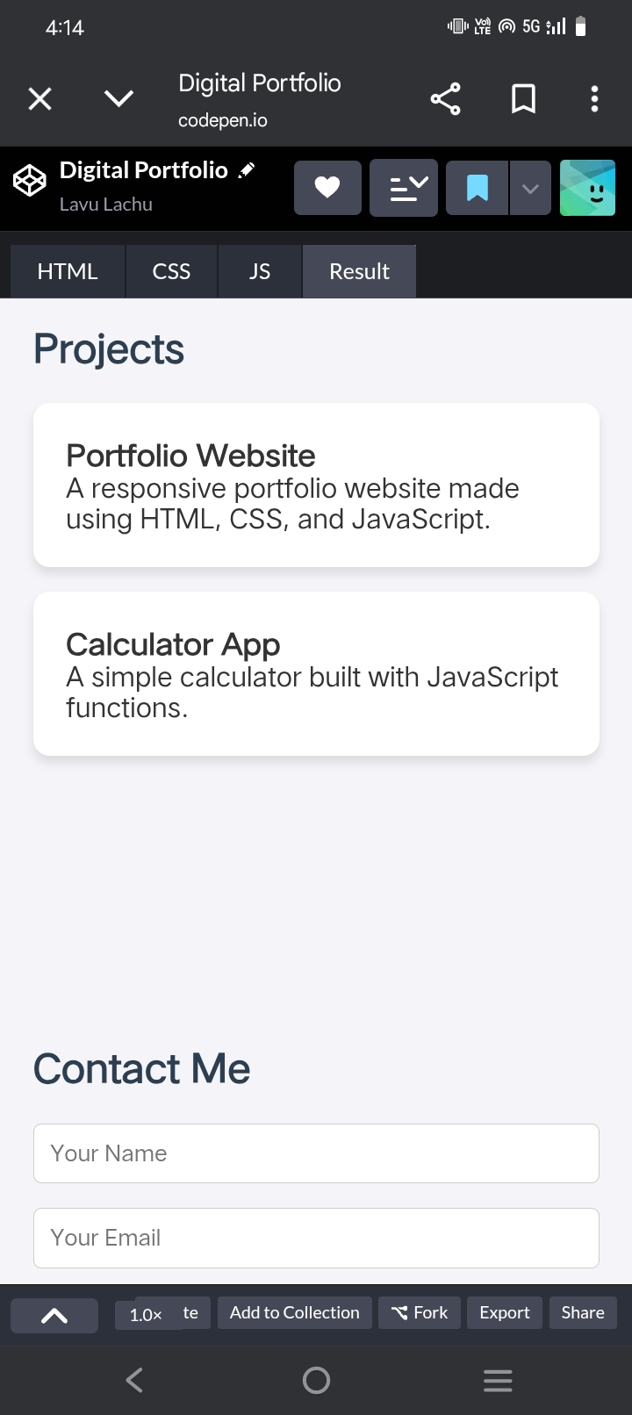
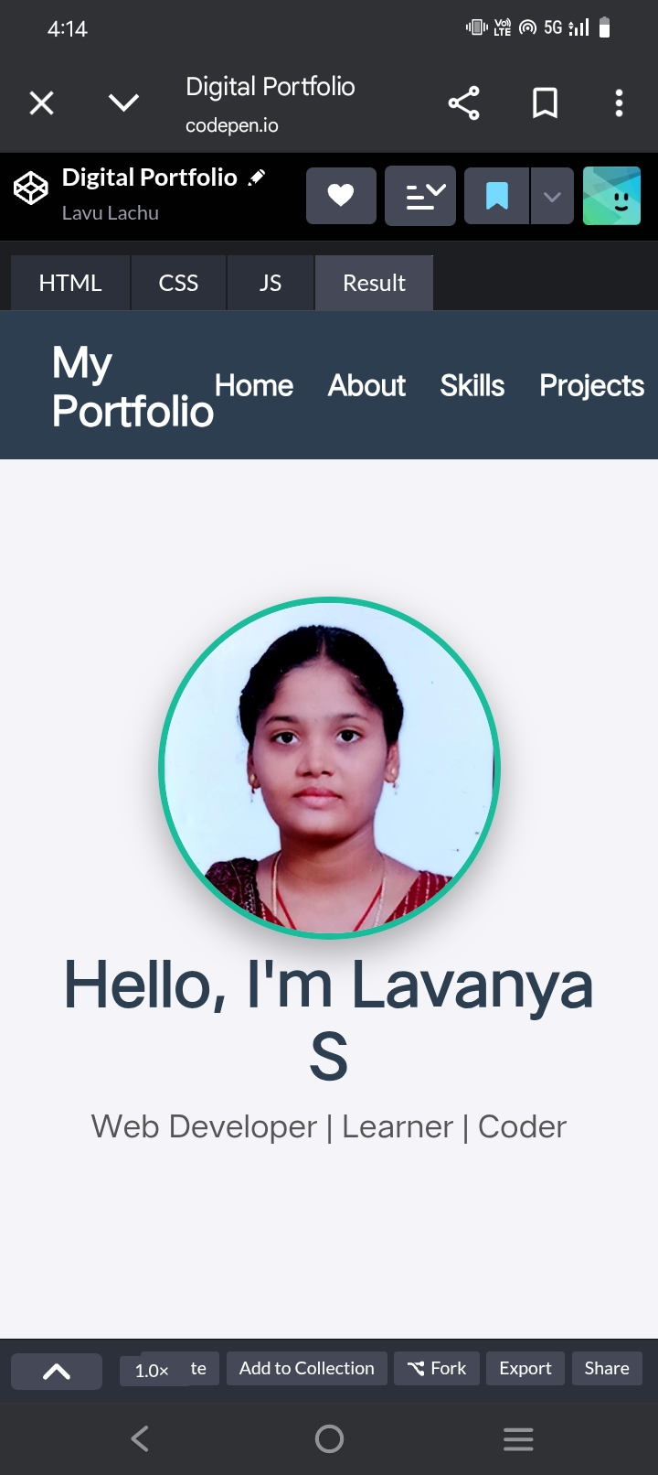
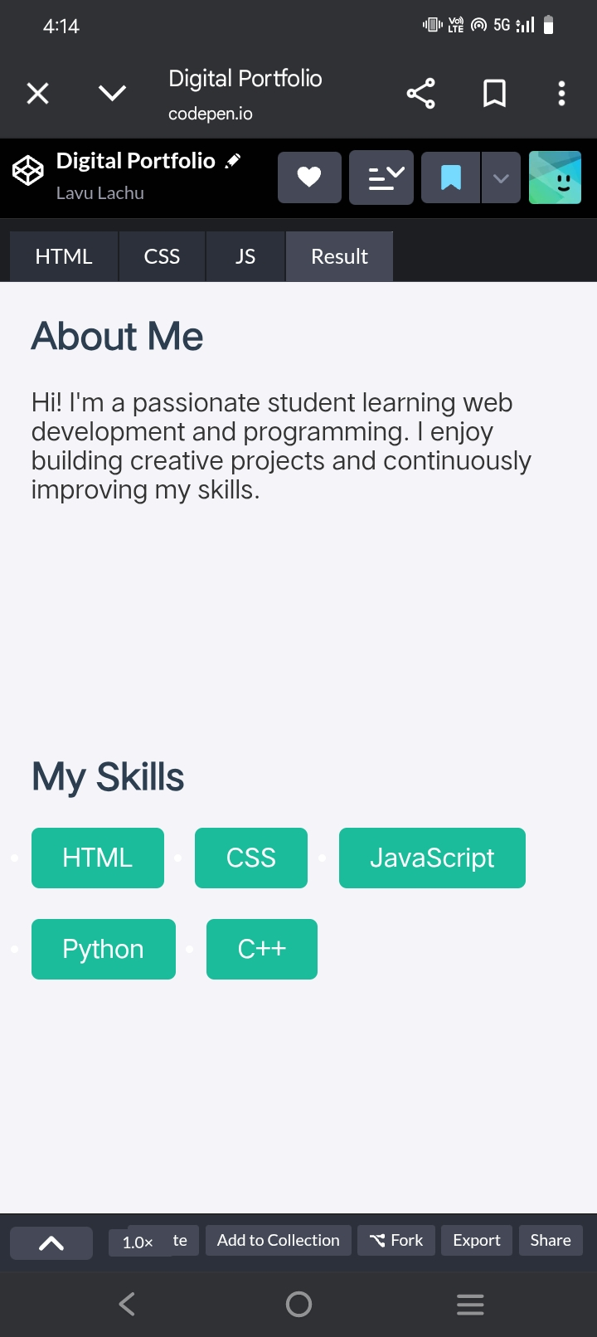
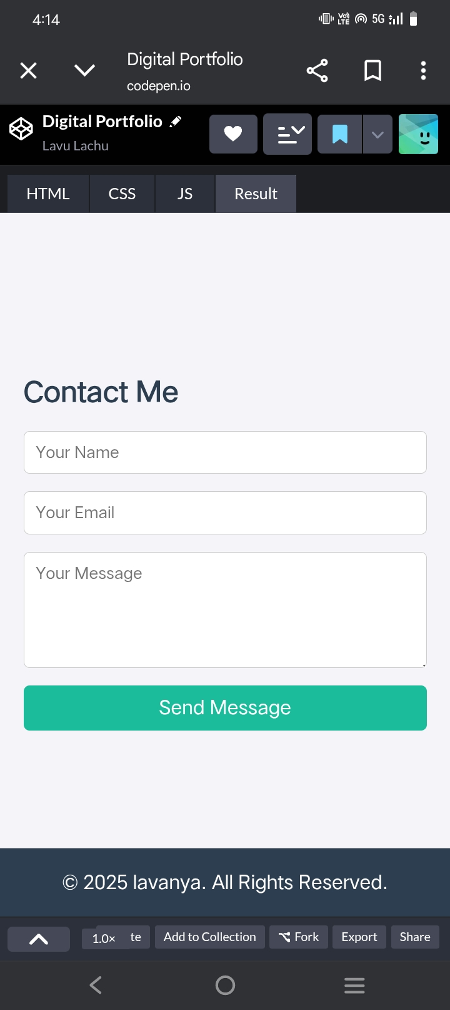

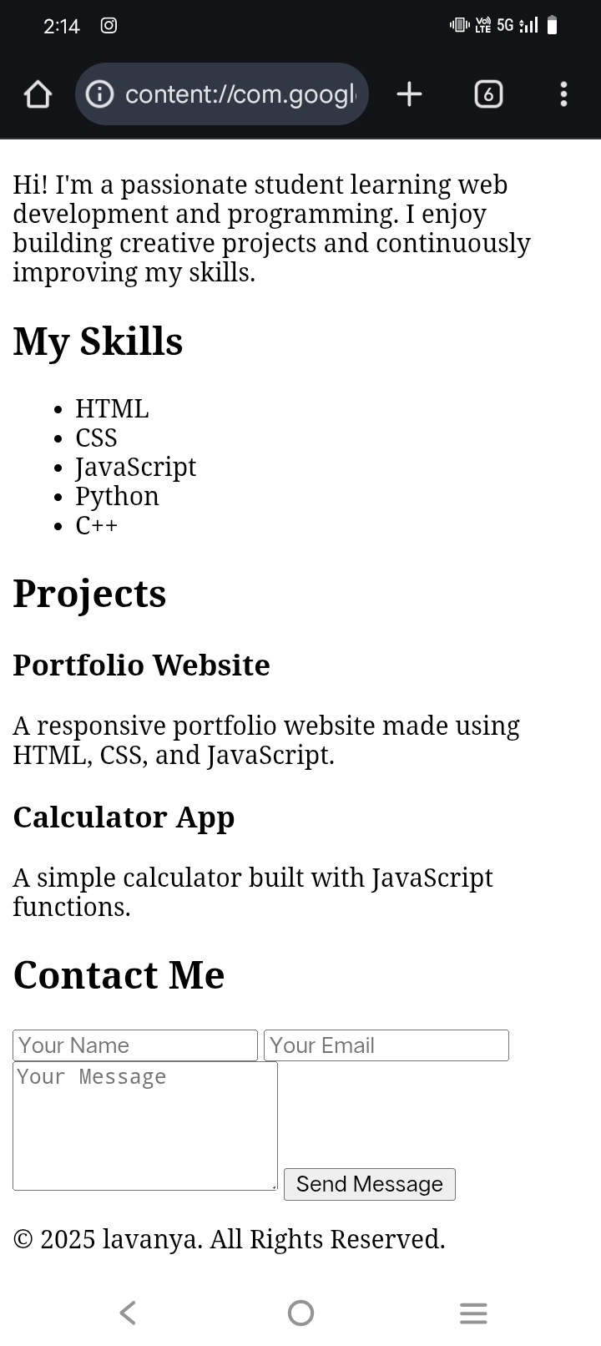
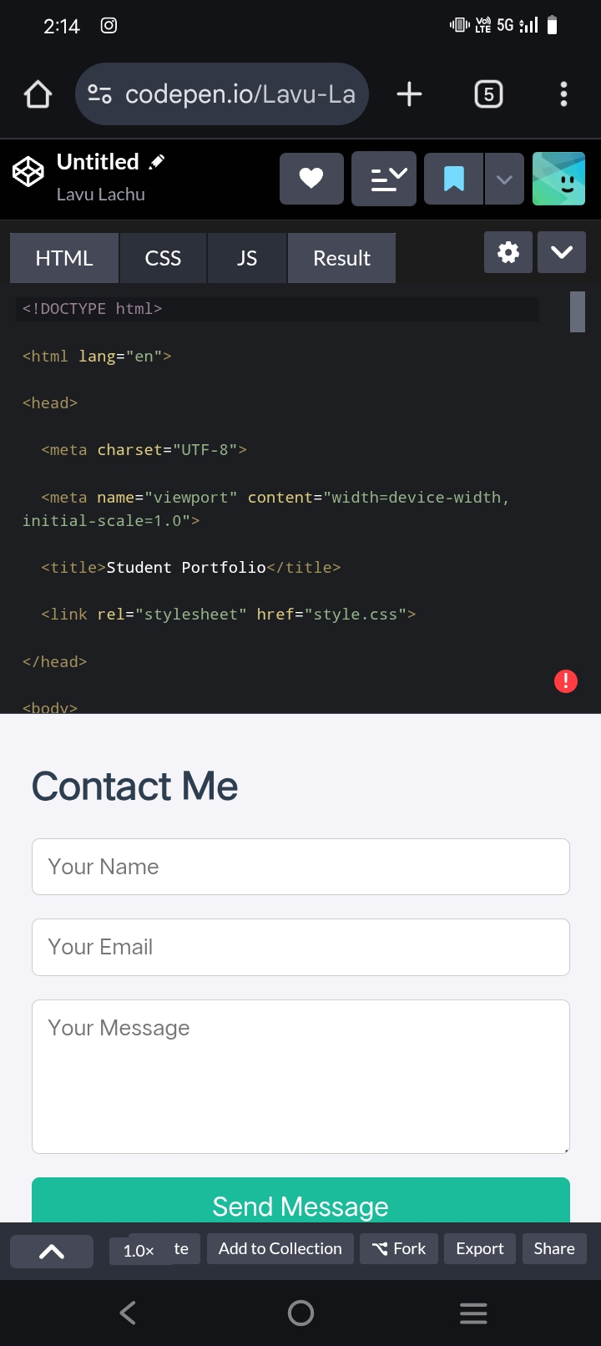
RESULTS AND SCREENSHOTS
Screenshots of each section
Before vs After (plain HTML with CSS & JS).
3/21/2024 Annual Review
10

Slide 11
CONCLUSION
The Student Portfolio Website was successfully developed using HTML, CSS, and JavaScript. The project provides a simple, user-friendly, and responsive platform for students to showcase their profile, skills, and projects.
11

